Slide 1
A PRIVACY PRESERVING FEDERATED LEARNING PLATFORM SECURED WITH AUTHORITY CONSENSUS USING BLOCKCHAIN
Department of Computer Science and Engineering​
CS6811 Final Year Project [2023]
Project Guide​
Dr.​ S. Sudha,
Professor, DCSE
College of Engineering,Guindy​
Anna University
Team 17
2019103066 - Srivatsav R​
2019103573 - Sachin Raghul T
2019103576 - Sanjeev KM

Slide 2
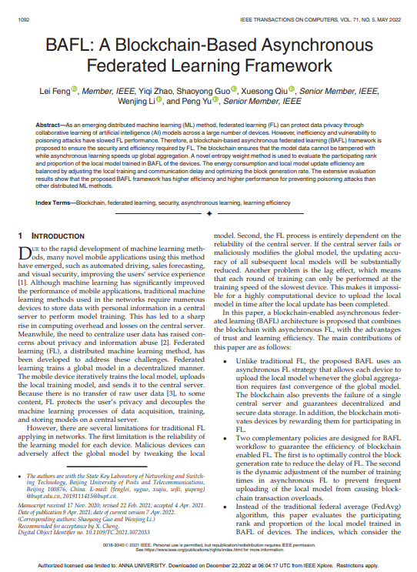
BASE PAPER
BAFL: A Blockchain-Based Asynchronous
Federated Learning Framework

Slide 3
INTRODUCTION
In recent years, there has been an enormous corpus of research and development dedicated to and focused on accelerating the processes of machine learning in every conceivable shape or form.
This provides greater flexibility and interoperability features than Monolith as they are easily scalable and robust to failures.
Computer hardware was not adequate enough to handle already existing machine learning algorithms, yet it seems the rapidly growing demand for machine learning applications has put us in a situation that yet again undermines the capabilities of individual machines.
The Solution for this problem is to multiple machines collaborate on training the model at hand.

Slide 4
INTRODUCTION
The idea of federated learning solves another major problem: the scarcity of data at a single machine. This is solved through the collaboration of different nodes in the training, each using its local data then sharing its model updates, realizing a single model trained on the sum of their local data.
In Federated Learning, they train it on their private data, then summarize and encrypt the model’s new configuration. The model updates are sent back to the cloud, decrypted, averaged, and integrated into the centralized model. Iteration after iteration, the collaborative training continues until the model is fully trained.
DFedL offers feasible solutions to common challenges in decentralized federated learning, namely, privacy, efficiency, and Byzantine fault-tolerance.

Slide 5
OVERALL OBJECTIVES
To achieve federated learning over decentralized network which eliminates following issues:
Central node inferring important information
Single point of failure on the server node
To prevent malicious clients, who tries to attack the global model with
incorrect gradients (Byzantine Imposter)
To solve the issue of expensive communication where each training node shares its update with all the other nodes using authority consensus

Slide 6
LITERATURE SURVEY
SNO | TITLE | METHODOLOGY | ADVANTAGES | LIMITATIONS
1 | Federated Learning System without Model Sharing through Integration of Dimensional Reduced Data Representations (2020) | Explored an federated learning system that enables integration of dimensionality reduced representations of distributed data prior to a supervised learning task, thus avoiding model sharing among the parties. | The Results show that this approach can achieve similar accuracy as Federated Averaging and performs better than Federated Averaging in a small-user setting. | Dimensionlity reduction may reduce accuracy in some cases

Slide 7
LITERATURE SURVEY
SNO | TITLE | METHODOLOGY | ADVANTAGES | LIMITATIONS
2 | Trustless Machine Learning Contracts; Evaluating and Exchanging Machine Learning Models on the Ethereum Blockchain (2018) | This paper discovered that it is possible to create contracts that offer a reward in exchange for a trained machine learning model for a particular data set. This would allow users to train machine learning models for a reward in a trustless manner. Contracts can be created easily by anyone with a dataset, even programmatically by software agents. | This will incentivize the creation of better machine learning models, and make AI more accessible to companies and software agents. | Without better design it leads to increase in gas cost

Slide 8
SNO TITLE
METHODOLOGY
ADVANTAGES
LIMITATIONS
3
Comparative Study of Byzantine Fault Tolerant Consensus Algorithms on Permissioned Blockchains (2020)
This paper provides idea for the private blockchains to use permissioned blockchain consensus algorithms as the participants need the permission of the authority to be able to join the system and investigated permissioned and permissionless blockchain,
Trust models between the nodes, incentives, number of nodes & parties involved, and scalability regarding the number of transactions.
Each application different
business
has problems
and priorities which is hard to generalise.
4
Federated Learning: Strategies for Improving Communication Efficiency (2017)
This paper proposed two ways to reduce the uplink communication costs in implementing federated learning: structured updates and sketched updates
Both convolutional and recurrent networks show that the proposed methods can reduce the communication cost by two orders of magnitude.
Reducing
communication cost
may lead downside security.
to of

Slide 9
SNO | TITLE | METHODOLOGY | ADVANTAGES | LIMITATIONS
5 | Consensus- Based Data- Privacy Preserving Data Aggregation (2019) | This paper addresses to solve the challenges in privacy preserving data aggregation by exploiting the distributed consensus technique. They first proposed a secure consensus-based DA algorithm that guarantees an accurate sum aggregation while preserving the privacy of sensitive data, then proved that the proposed algorithm converges accurately. | Extensive simulations have shown that the proposed algorithm has high accuracy and low complexity, and they are robust against network dynamics. | Intensive simulation may lead to low accuracy and high complexity
6 | A PoW-less Bitcoin with Certified Byzantine Consensus (2022) | This paper explored one possible way to solve the problem where the Distributed Ledger Technologies, when managed by a few trusted checkers requires most but not all of the machinery available in public DLTs. | The combined protocol may operate as a modern,safe foundation for digital payment systems and Central Bank Digital Currencies. | PoA is more centralised compared to PoW

Slide 10
SNO | TITLE | METHODOLOGY | ADVANTAGES | LIMITATIONS
7 | Federated learning in medicine: facilitating multi- institutional collaborations without sharing patient data (2020) | This paper investigated the effects of data distribution across collaborating institutions on model quality and learning patterns, indicating that increased access to data through data private multi-institutional collaborations can benefit model quality more than the errors introduced by the collaborative method. | Models having a catalytic impact towards precision/persona lized medicine. | Errors may occur if done in small scale
8 | Privacy-Preserving Resource Sharing Using Permissioned Blockchains, (2021) | Designed a decentralized resource sharing platform that uses a permissioned blockchain to allow users to share their digital items with their specified attributed-based access policies that are enforced through a set of smart contracts, and removes the need for a trusted intermediary. | This decentralized attribute-based access control system achieves the same functionality while preserving the privacy of user’s access | It has limited availability, has access to the resource requires it’s owner to be online.

Slide 11
SNO | TITLE | METHODOLOGY | ADVANTAGES | LIMITATIONS
9 | A Hybrid Approach to Privacy- Preserving Federated Learning (2019) | This paper proposed a Hybrid Approach to Privacy- Preserving Federated Learning by Combining differential privacy with secure multiparty computation which enables to reduce the growth of noise injection as the number of parties increases without sacrificing privacy while maintaining a pre- defined rate of trust. | This system can be used to train a variety of machine learning models, which demonstrate that our approach out-performs state of the art solutions. | Hybrid approach leads to moderate privacy and security
10 | Blockchain-enabled Federated Learning: A Survey (2023) | Introduced a Blockchain-enabled Federated Learning that has been and will keep generating widespread attention in this big data era. However, the existing paradigms become increasingly impractical and difficult to follow from both perspectives of introductory and in-depth exploration of state-of-the- art models. | Systematically introduced the evaluation matrix and analysis criteria | Lacking consensus algorithm as it may be prone to attacks

Slide 12
SUMMARY OF ISSUES
Each business application has different problems and priorities which is hard to generalize.
Reducing communication costs may lead to downside of security.
Intensive simulation may lead to low accuracy and high complexity.
Proof of Authority is more centralized when compared with Proof of Work.

Slide 13
PROPOSED SYSTEM
We propose a framework Decentralized Federated Learning (DFedL) for building a generic decentralized federated learning system using the blockchain technology, accommodating any machine learning model that is compatible with gradient descent optimization.
DFedL uses proof-of-concept used to spawn mini-systems – checkers and clients. The system design comprising of two decentralized actors: client and checker, alongside the methodology for ensuring reliable and efficient operation of the system.
Hence, DFedL as an experimental sandbox to compare and contrast the effects of client-to-checker ratio, reward-penalty policy, and model synchronization schemes on the overall system performance, ultimately showing by example that a decentralized federated learning system is indeed a feasible alternative to more centralized architectures.

Slide 14
ARCHITECTURE DIAGRAM

Slide 15
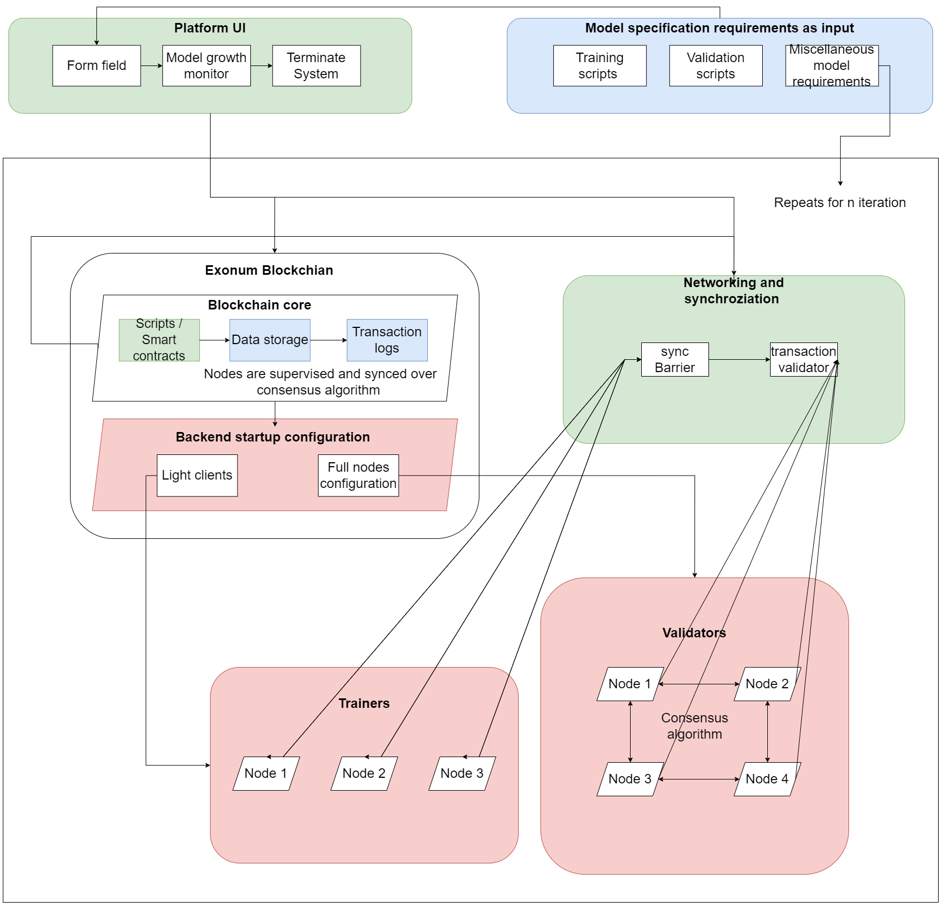

Slide 16
LIST OF MODULES
Model Specification and platform UI
Blockchain core and startup configuration
Networking and synchronization
Model clients
Model checkers

Slide 17
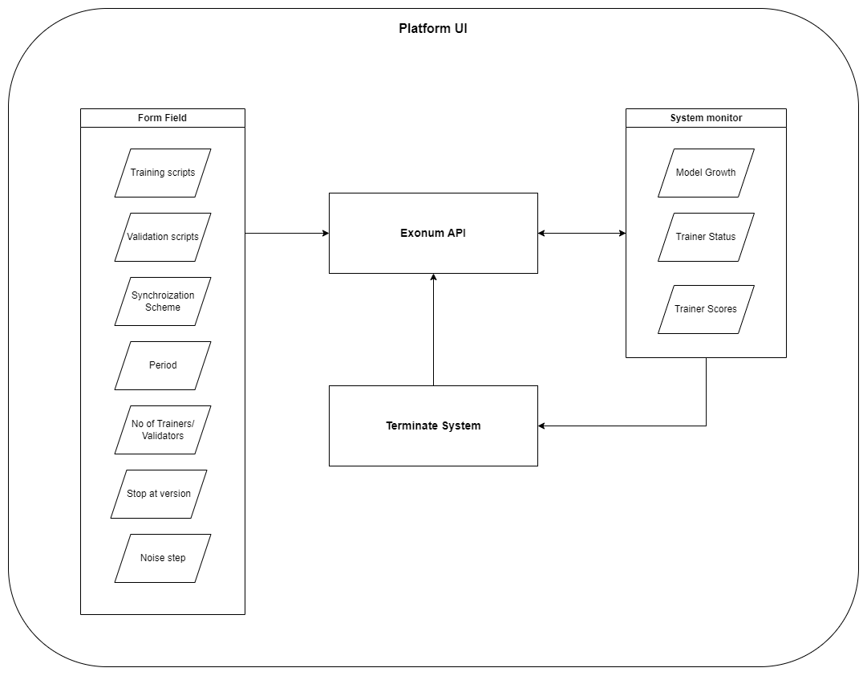
Module 1 - Model Specification and platform UI

Slide 18
Module 1 - Model Specification and platform UI
INPUT: Training and validation Scripts and Number, Synchronization scheme, Noise step
OUTPUT: Forwards to startup configuration.
STEPS:
1)Develop application to get the scripts to distribute them across clients and checkers to train the local dataset upon it.
2) User can configure the system to run model
3) Configuration can be done on
fixing amount of clients and checkers,
choice on Synchronization Scheme (BAP, BSP, SSP),
Stop at version
Noise step
3) To monitor the model growth system is equipped with client status and client scores
4) Creating the jobs and start training
5) Terminating thre process

Slide 19
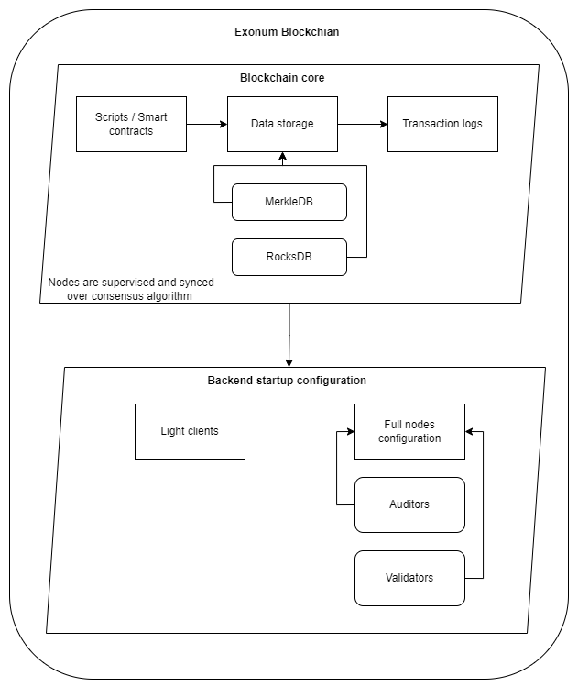
Module 2 - Blockchain core and startup configuration

Slide 20
Module 2 - Blockchain core and startup configuration (1/2)
INPUT: Parameters for Environment Creation
OUTPUT: checkers and clients Environment
Data storage, which contains data structured into objects. Objects represent high-level wrappers over the key-value store.
Transaction log, i.e., the complete history of all transactions ever applied to the data storage.
Exonum gathers transactions into blocks; the whole block is approved atomically.
After a block is approved, every transaction in it is executed sequentially, with changes applied to the data storage.
Smart contracts define business logic of the blockchain, allow to retrieve data from the blockchain, and can be reused across different projects.

Slide 21
Module 2 - Blockchain core and startup configuration (2/2)
STEPS:
Full nodes replicate the entire contents of the blockchain and correspond to replicas in distributed databases. All the full nodes are authenticated with public-key cryptography.
Full nodes are further subdivided into 2 categories Auditors and checkers
Auditors replicate the entire content of the blockchain. They can generate new transactions, but cannot choose which transactions should be committed
Only checkers can generate new blocks by using a Byzantine fault tolerant consensus algorithm. checkers receive transactions, verify them, and include into a new block.
Light clients represent clients in the client-server paradigm; they connect to full nodes to retrieve information from the blockchain they are interested in and to send transactions.

Slide 22
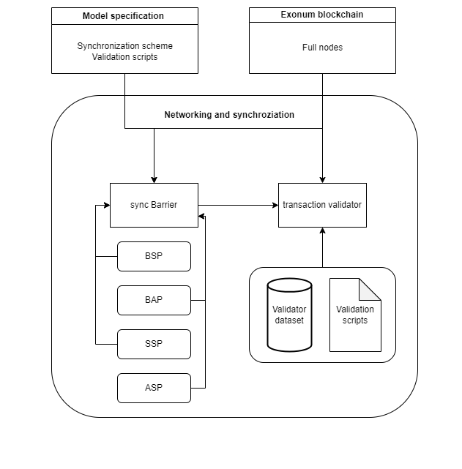
Module 3 - Networking and synchronization

Slide 23
Module 3 - Elastic Scalability (2/2)
INPUT: Sync updated parameters from clients and validates with checkers
OUTPUT: Commits the transaction logs in exonum blockchain
There are many techniques to handle node update synchronization to prevent model degradation
In Bulk Synchronous Parallel (BSP) each training round is limited by a fixed period that ends with a strict deadline after which no further client updates are considered for that round.
In Stale Synchronous Parallel (SSP) SSP is modelled as BSP with the possibility of a deadline extension when proportion to the ratio of clients that have not yet finished training for that round
Barrierless Asynchronous Parallel (BAP) BSP as it almost totally eliminates the cost of synchronization by allowing wait less, asynchronous communication between nodes
Trust scores are adjusted based on validation results.
Upon receiving a client update, a checker adds its gradients to the latest model weights, and computes its validation score.

Slide 24
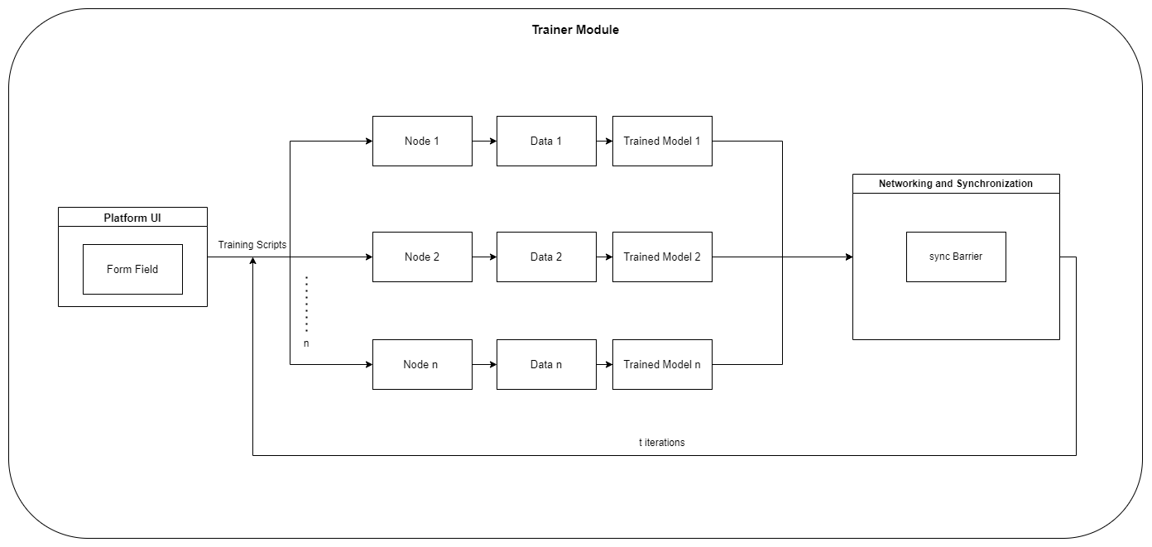
Module 4 - Model clients

Slide 25
Module 4 - Model clients
INPUT: client scripts
OUTPUT: Updated model parameters
Performs model training including all needed intermediate transformations such as model flattening and rebuilding at the client side.
This layer sends and receives flattened models and flattened gradients built on top of exonum lightweight clients.
To improve system auditability, Exonum includes a light client. Light client is a JavaScript library with a number of helper functions available for use by frontend developers.
There are two typical use cases for the light client forming and sending transactions to the Exonum blockchain network
Forming requests to full nodes of the network (normally, HTTP GET requests) and validation of the responses

Slide 26
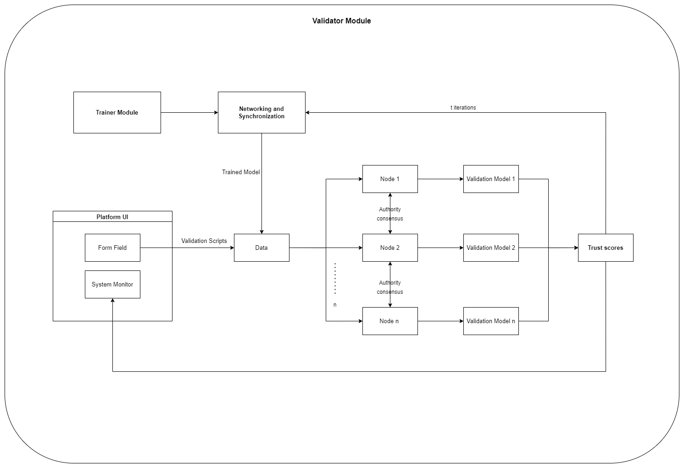
Module 5 - Model checkers

Slide 27
Module 5 - Model checkers
INPUT: Updated model parameters and client scripts.
OUTPUT: Trust scores
checkers are responsible for maintaining models on the underlying blockchain network through decentralized consensus based on voting.
Ideally, a checker’s vote, on whether some update to the model (made by a client node) is acceptable, should be decided by validation on data presumably unrevealed to the client.
That, combined with the voting-based nature of consensus, stipulates the following requirements and assumptions in order for the system to operate soundly.
One important property is that clients are not fully connected to the checkers while checkers are fully interconnected.
yet a node can be a checker on a subnetwork while being a client for another. Further, each model subnetwork requires at least one checker to function.

Slide 28
IMPLEMENTATION DETAILS

Slide 29
Blockchain Setup (Exonum):
Exonum is written in Rust and depends on the following third-party system libraries:
RocksDB (persistent storage)
libsodium (cryptography engine)
Protocol Buffers (mechanism for serializing structured data)
Prerequisites:
git
Node.js with npm
Rust compiler
Exonum launcher

Slide 30
Dependencies installation:
For distributives with deb-based package managers (such as Debian or Ubuntu), use
add-apt-repository ppa:exonum/rocksdb
apt-get update
apt-get install build-essential jq libsodium-dev libsnappy-dev libssl-dev \
librocksdb6.2 pkg-config clang-7 lldb-7 lld-7
For protobuf installation add the following dependencies:
add-apt-repository ppa:maarten-fonville/protobuf
apt install libprotobuf-dev protobuf-compiler

Slide 31
Package names and installation methods may differ in other Linux distributives; use package manager tools to locate and install dependencies.
Depending on the version of your distributive, libsodium, RocksDB and Protobuf may not be present in the default package lists. In this case you may need to install these packages from third-party PPAs, or build them from sources.
Adding Environment Variables
If your OS contains pre-compiled rocksdb or snappy libraries, you may setup ROCKSDB_LIB_DIR and/or SNAPPY_LIB_DIR environment variable to point to a directory with these libraries. This will significantly reduce compile time.
export ROCKSDB_LIB_DIR=/usr/lib
export SNAPPY_LIB_DIR=/usr/lib/x86_64-linux-gnu

Slide 32
Rust Toolchain
Exonum repositories use the stable Rust toolchain that can be installed by using the rustup program:
curl https://sh.rustup.rs -sSf | sh -s -- --default-toolchain stable
Compiling Exonum
We can verify that you installed dependencies and the Rust toolchain correctly by cloning the exonum repository and running its built-in unit test suite:
git clone https://github.com/exonum/exonum.git
cd exonum
cargo test -p exonum

Slide 33
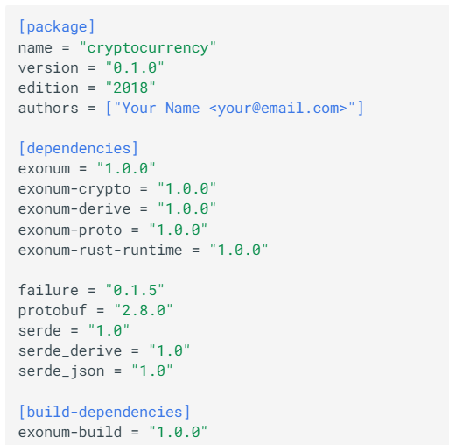
Necessary dependencies(Cargo.toml):
Figure 18.1. NECESSARY DEPENDENCIES
Figure 18.2. NECESSARY DEPENDENCIES

Slide 34
Generate node configuration template:
mkdir example
exonum-<project-name> generate-template \
example/common.toml \
--checkers-count 4
Generate public and secret keys for each node:
exonum-<project-name> -advanced generate-config \
example/common.toml example/1 \
--peer-address 127.0.0.1:6331 -n
exonum-<project-name> generate-config \
example/common.toml example/2 \
--peer-address 127.0.0.1:6332 -n
exonum-<project-name> generate-config \
example/common.toml example/3 \
--peer-address 127.0.0.1:6333 -n
exonum-<project-name> generate-config \
example/common.toml example/4 \
--peer-address 127.0.0.1:6334 -n

Slide 35
Finalize configs:
exonum-<project-name> finalize \
--public-api-address 0.0.0.0:8200 \
--private-api-address 0.0.0.0:8091 \
example/1/sec.toml example/1/node.toml \
--public-configs example/{1,2,3,4}/pub.toml
Similar commands for other 3 nodes, with adjusted paths and socket addresses
Run nodes:
exonum--<project-name> run \
--node-config example/1/node.toml \
--db-path example/1/db \
--public-api-address 0.0.0.0:8200 \
--master-key-pass pass
Similar commands for other 3 nodes, with adjusted paths and socket addresses

Slide 36
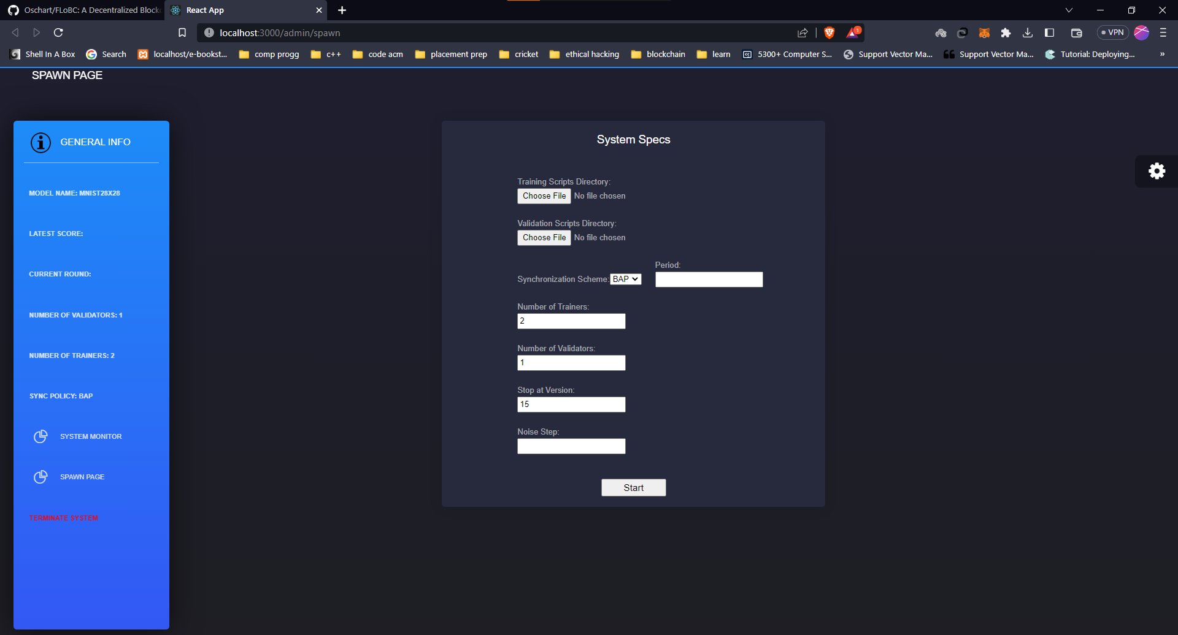
Filling Requirements in Spawn Page :
Frontend is connected to node server via REST api. All the requirements to spawn the system is passed to node server which will run script to initiate client and checker nodes

Slide 37
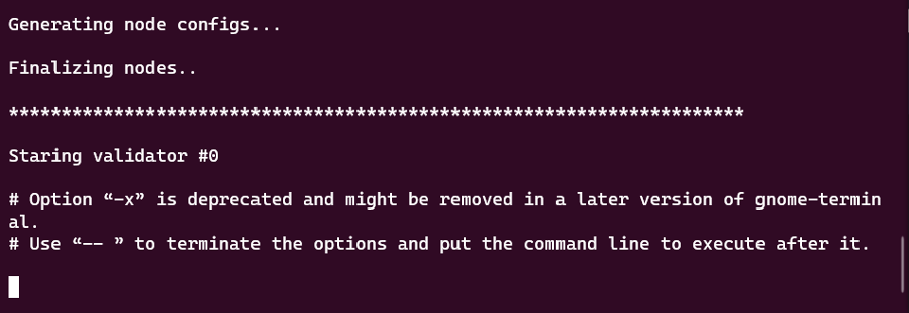
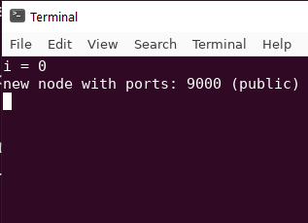
Starting checker Node :
Backend node spawn script starts the mentioned number of checkers and the checker nodes starts receiving for model updates by the clients
SPAWN SCRIPT BOOTING UP THE checkers
checker WAITING FOR MODEL UPDATE
BY clients

Slide 38
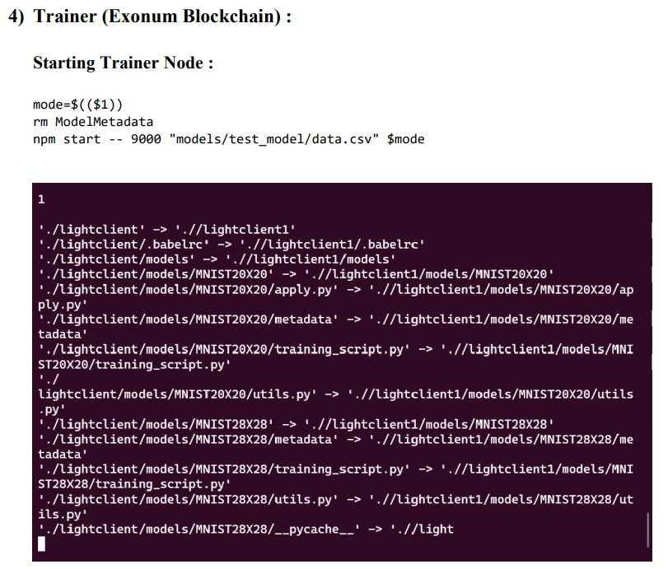
Starting checker Node :
Backend node spawn script starts the mentioned number of clients that trains the model with local data and sends it to the checker node
Miners/clients – Light Clients (in Exonum)
SPAWN SCRIPT BOOTING UP THE LIGHT CLIENT (clients)

Slide 39
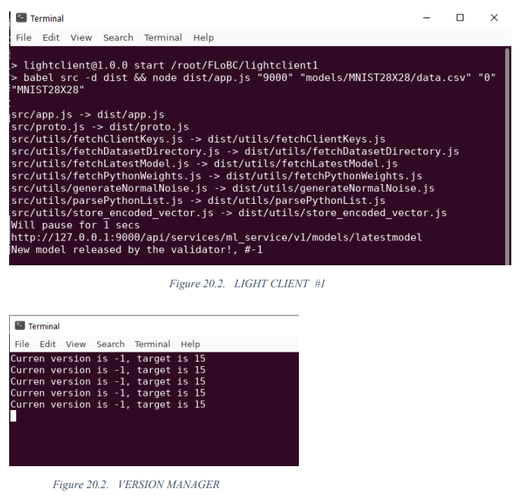
Starting checker Node :
Version manager is used to manage the current version of the released model with the target version
Due to CPU restrictions, we have done the demo for 2 clients and 1 checker. Further this can be extended with the help of powerful CPUs

Slide 40
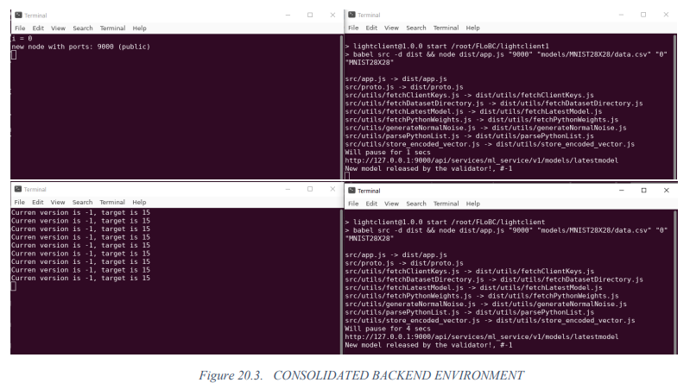
checker console
client console #1
Version controller
client console #2

Slide 41
Model Released by client :
client trains the model with local data and shares the model parameters with the checkers, asynchronously. clients are allowed to train for as long as a round may extend; that is, until a new model is released, clients can keep advancing local training, periodically sharing it with a checker. A new model is released when a minimum ratio of labor has been submitted, and that’s when clients should pull in the new model.

Slide 42
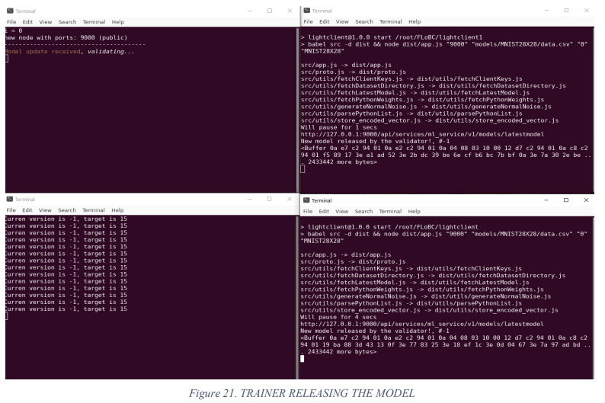
checker console
client console #1
clients updating their weights with
checkers and checkers validating them
Version Controller
client console #2

Slide 43
Validating Model :
The model released by the client is validated by the checker using validating sample to check for any Byzantine attack. If the model accuracy is greater than the threshold accuracy then new model version is released by aggregating the previous version with the current version using aggregator function. Then the new aggregated model is synced across other checkers and clients. If the current version reaches the target version then the model is available for download.

Slide 44
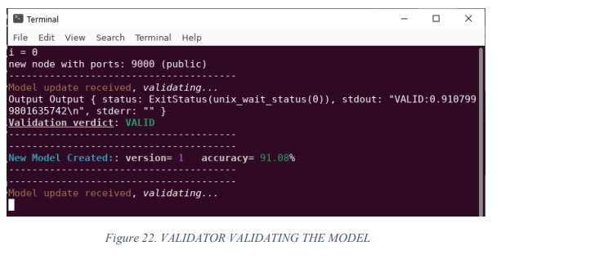
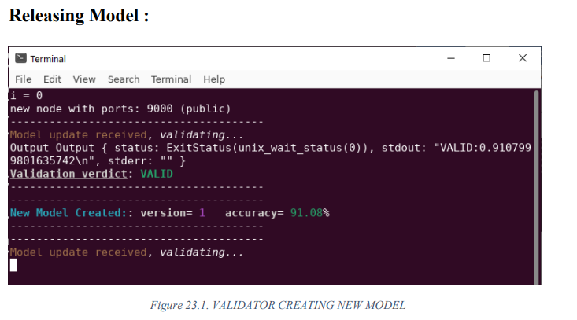

Slide 45
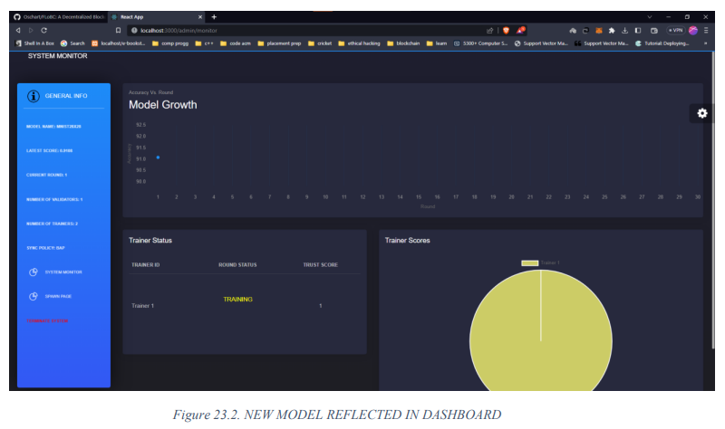

Slide 46
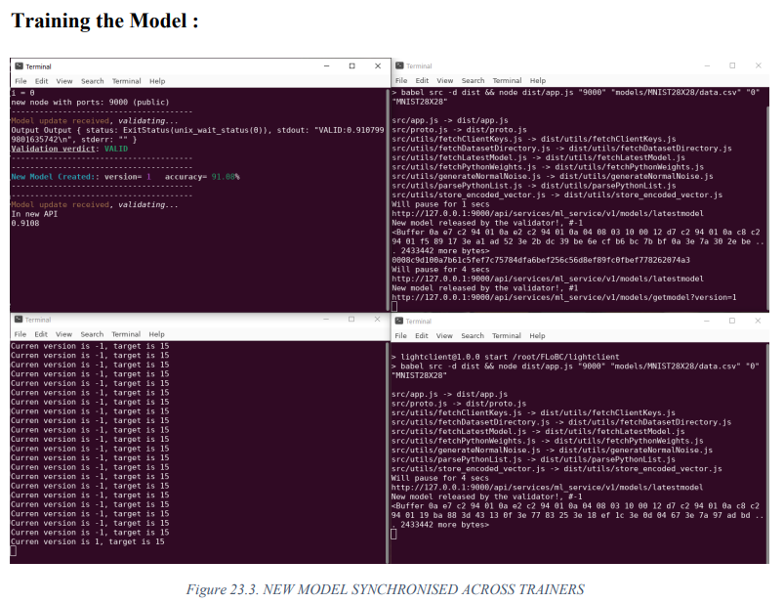
checker console
client console #1
Version controller
client console #2

Slide 47
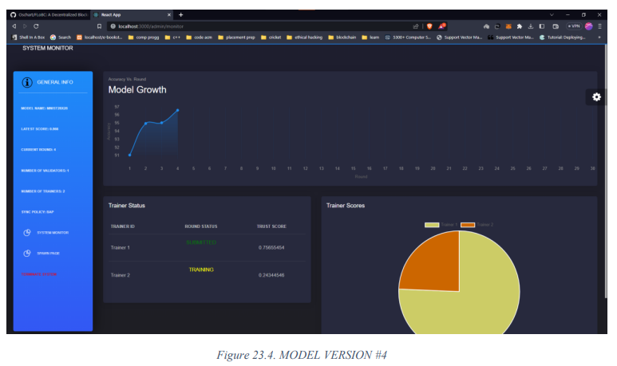

Slide 48
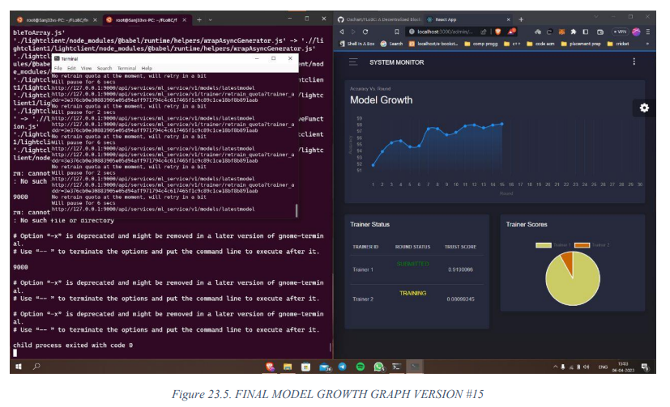

Slide 49
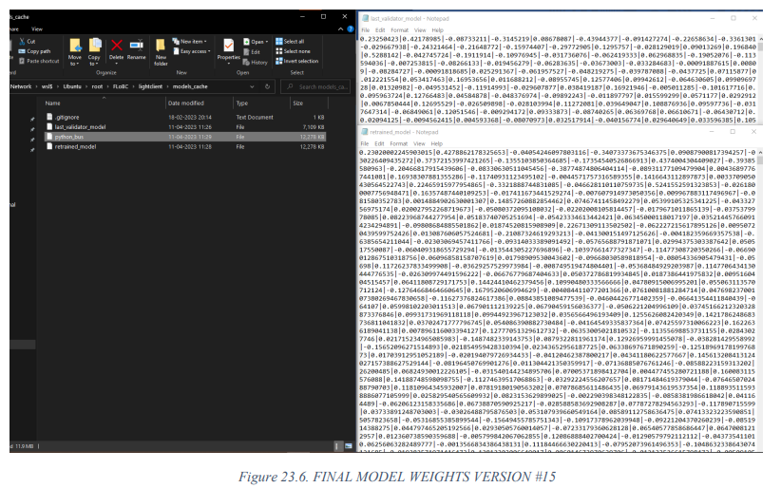

Slide 50
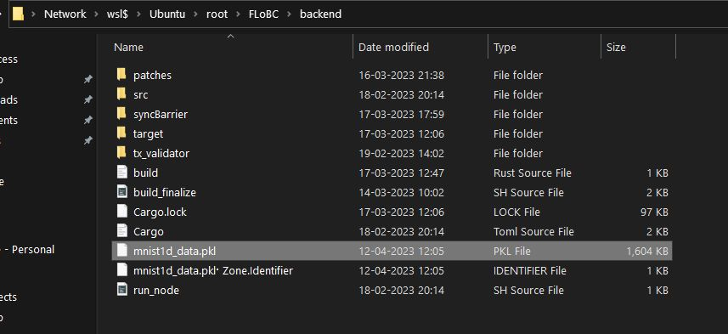
Finally, the trained model has been downloaded

Slide 51
TEST CASES
1) | When clients and checkers are less than or equal to 0 | Link
2) | When period is 0 and the scheme is synchronous | Link
3) | When spot at version is left null or is filled with float value | Link
4) | Force Terminating System | Link
5) | Synchronization policy | Link
6) | Sync Signal Propagation | Link
7) | Sending Model Parameters | Link
8) | Validating Model Parameters | Link
9) | Releasing New Model | Link
10) | Reflecting model update in frontend | Link

Slide 52
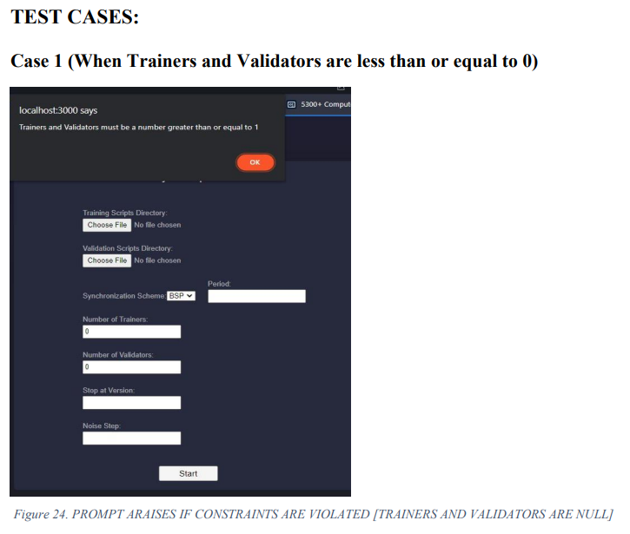
Input : Clients and checkers are <= 0
Output : Alert prompt appears if clients and checkers are less than or equal to 0

Slide 53
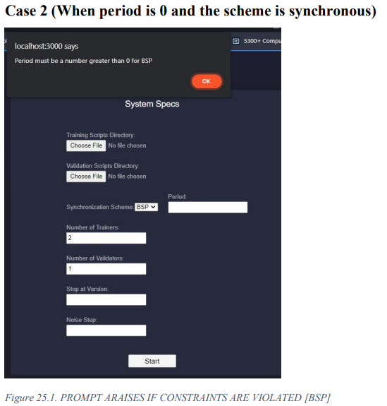
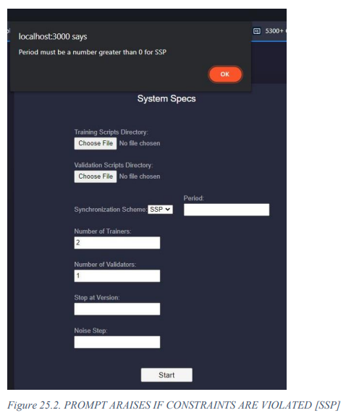
Input : Synchronous scheme and period is 0
Output : Alert prompt appears if period is 0 and scheme is synchronous

Slide 54
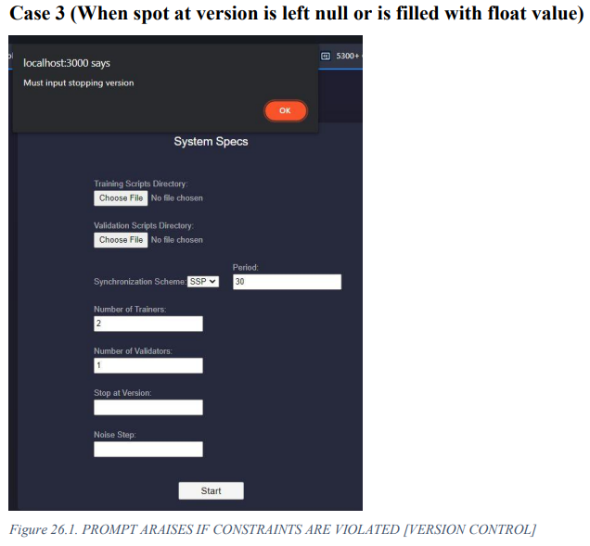
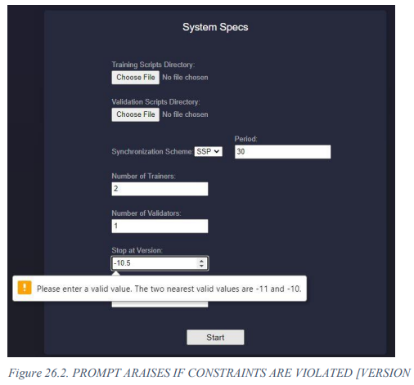
Input : Stop at version field is left null or filled with float value
Output : Alert prompt appears to rectify the stop at version field

Slide 55
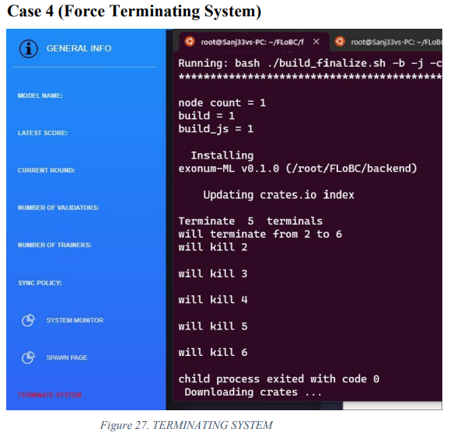
Input : Fore kill framework instance signal sent to REST API
Output : The framework instance should kill and clear all the residues from blockchain

Slide 56
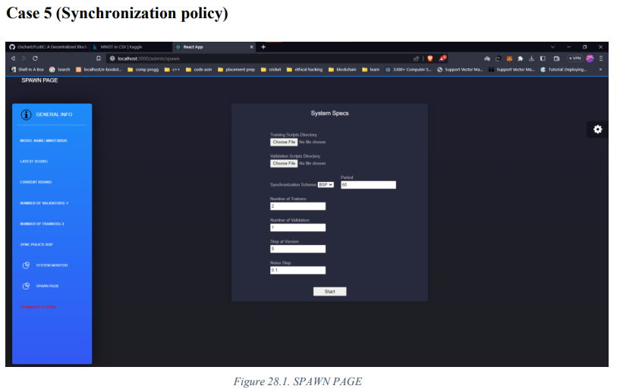
Input : Synchronization scheme chosen from the frontend dropdown
Output : API correctly interprets the policy and spawns clients and checkers corresponding to the policy

Slide 57
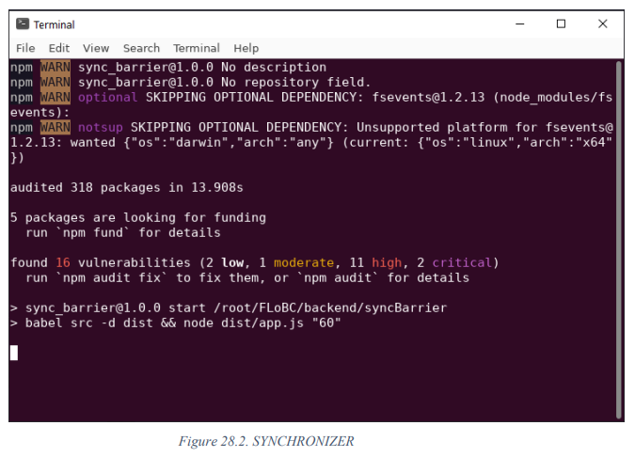

Slide 58
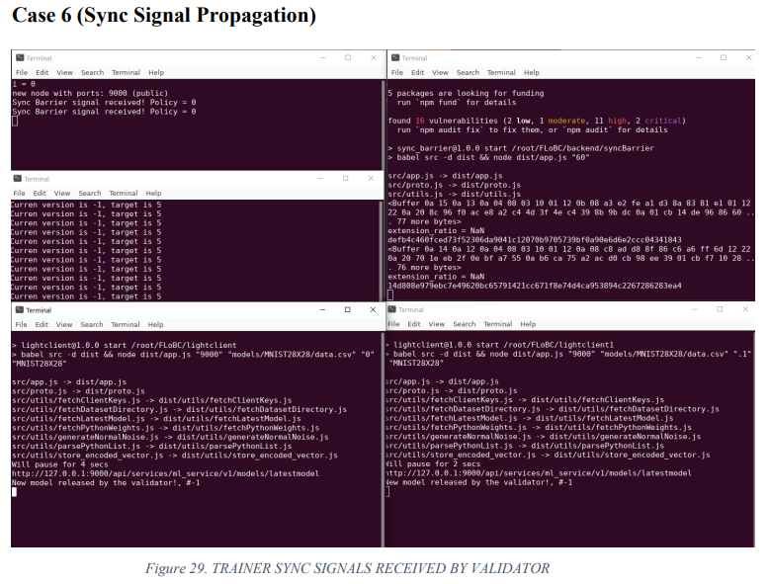
checker console
Synchroniser
Input : Clients and checkers are created
Output : Clients and checkers communicate with each other and shares model updates
Version controller
client console #1
client console #2

Slide 59
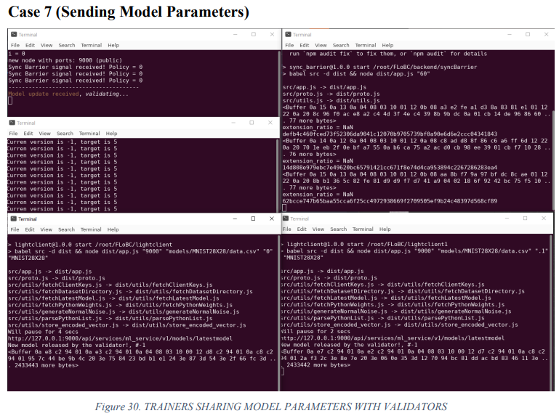
checker console
Synchroniser
Input : Clients train the model with local dataset
Output : Trained model updates are shared to checkers
Version controller
client console #1
client console #2

Slide 60
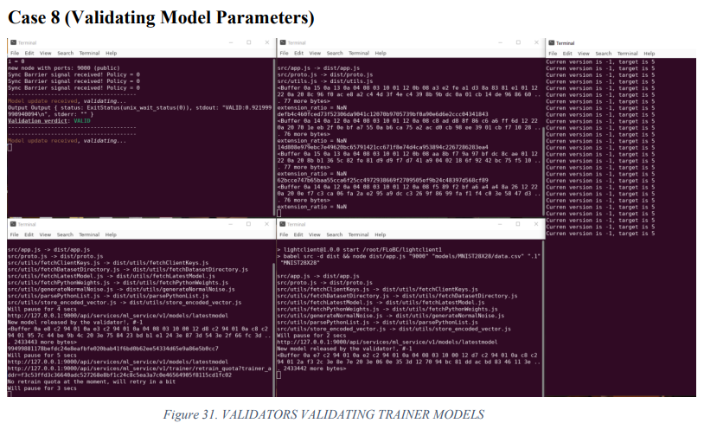
checker console
Synchroniser
Version controller
Input : All trainers shared their model updates
Output : A new model is released which aggregates the updates from all clients
client console #1
client console #2

Slide 61
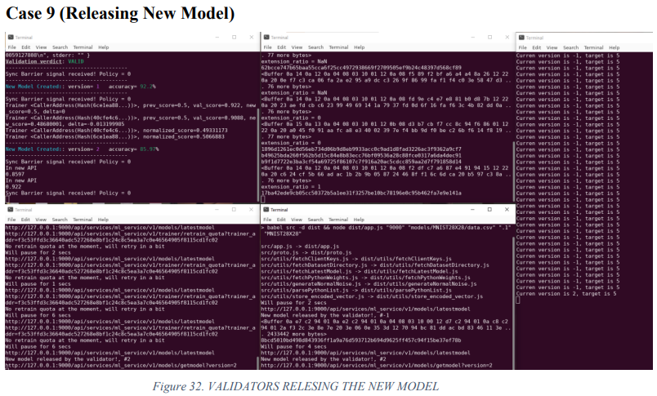
checker console
Synchroniser
Version controller
Input : New model is released by the checker
Output : All clients will receive the new model update from the checker
client console #1
client console #2

Slide 62
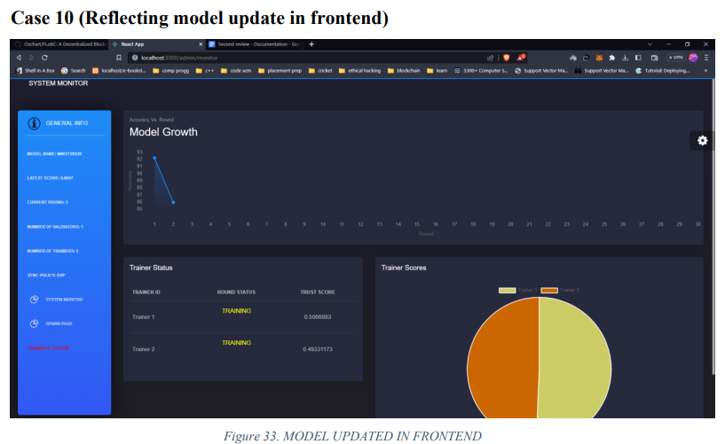
Input : New model is released
Output : New model metadata is updated in the frontend and in its buffer

Slide 63
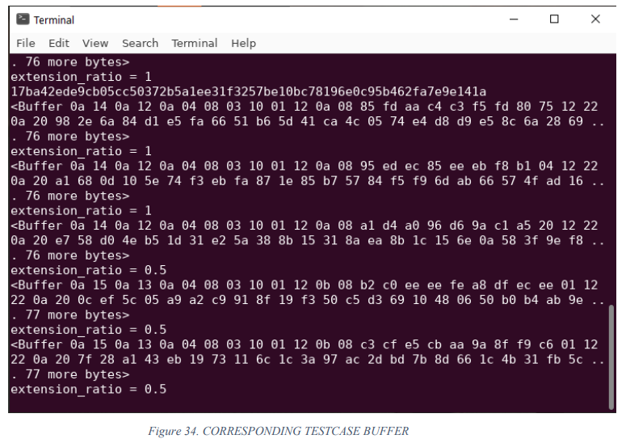

Slide 64
PERFORMANCE MEASURES
Benchmark: Decentralized vs. Centralized Performance
The purpose of this comparison is to check whether the security and privacy achieved from decentralized computing comes with a trade-off from loss of model quality and accuracy or whether model accuracy is unaffected by the advantages imposed by the decentralized model.

Slide 65
PERFORMANCE MEASURES
Benchmark: Decentralized vs. Centralized Performance
.

Slide 66
PERFORMANCE MEASURES
Benchmark: Decentralized vs. Centralized Performance
RESULT:
From the graph we can infer that with decentralized approach the model accuracy stays low as compared to centralized model for initial few numbers of iterations (6 – 7), it takes time to build up on the model accuracy as many decentralized actors would be contributing to build a model in each iteration with different datasets for them to train on. After initial few iterations we can infer that accuracy of centralized and decentralized model are in comparable with each other, and ends up with decentralized model having just 0.8% accuracy less than the centralized model. As for the benefits of security and privacy the decentralized model provides a very small percentage loss in accuracy is acceptable, also the trend can be subjected to change on different dataset or with more iterations where accuracy of both models would be similar.

Slide 67
PERFORMANCE MEASURES
clients-to-checkers Ratio
The purpose of this comparison is to check whether the difference in number of clients and checkers affects model accuracy, if so then we have to estimate the ratio of clients and checkers which would lead us to higher accuracy model as compared to others.

Slide 68
PERFORMANCE MEASURES
clients-to-checkers Ratio

Slide 69
PERFORMANCE MEASURES
clients-to-checkers Ratio
RESULT:
As we can infer from the graph lower number of clients has very ow accuracy, because they are trained on very low number of dataset rows, thus leading to lowest accuracy. And as the clients increases the model is trained on diverse number of dataset instances thus accuracy increases. And during 9 clients and 1 checker there is a bottleneck in checkers side as it cannot validate all 9 model instances which decreases the accuracy eventually. Thus Clients: Checkers ratio 8:2 should be maintained in order to achieve higher accuracy model with maximum utilization of available resources.

Slide 70
PERFORMANCE MEASURES
Authority consensus Policy
Another main component of D-FedL framework is Authority consensus which is responsible to make the overall system stable by avoiding model updates from the clients which constantly provides low quality model by penalising them and rewarding the clients with good quality model. The goal of the experiment is to compare the model growth with consensus and without it, and to infer whether usage of authority consensus increases model accuracy and stability.

Slide 71
PERFORMANCE MEASURES
Authority consensus Policy

Slide 72
PERFORMANCE MEASURES
Authority consensus Policy
RESULT:
As we could infer from the graph, we could see large deviation in accuracy of the model trained without consensus, because nodes that provide low quality model would eventually bring down the accuracy of the model thus more fluctuation in model accuracy. Whereas on other hand model trained with authority consensus had very low deviation in the accuracy in successive rounds because it will stop receiving model updates from low performing nodes which increases model stability and model accuracy. After 15 rounds accuracy of the model trained with consensus came out to be 97.4% and the model without consensus was 91.9%, as we could notice the huge 5.5% difference in model accuracy between models trained with and without consensus. Thus using authority consensus seems to have improved model accuracy and stability.

Slide 73
COMPARATIVE MEASURES
Synchronization Schemes
In this experiment, we compare some of the common synchronization schemes used in parallel computing after adapting our own variations of them. The schemes implemented in DFedL and those tested in the experiment are Bulk Synchronous Parallel (BSP), Stale Synchronous Parallel (SSP), and Barrierless Asynchronous Parallel (BAP), as previously described in the methodology.

Slide 74
COMPARATIVE MEASURES
Synchronization Schemes

Slide 75
COMPARATIVE MEASURES
Synchronization Schemes
RESULT:
As we could infer from the graphs, at the end of 15 iterations the model accuracy of both synchronous and asynchronous schemes is almost same, but when we ran the system through particular time frame i.e) 15 minutes we could see BSP has higher number of iterations in 15 minutes but it has lower accuracy, followed by SSP which had completed 10 iterations in 15 minutes with higher accuracy and asynchronous scheme which has completed just 6 iterations.
Though model accuracy is same at similar iteration, when it comes into the efficiency of using their resources synchronization schemes outperform asynchronous scheme by completing more iterations in fixed time frame.
.

Slide 76
COMPARATIVE MEASURES
Model Accuracy vs No of Iterations
From this experiment, the goal is to find whether the highest number of iterations till which the model is not affected by overfitting which decreases the model accuracy and find which synchronization scheme is more susceptible to overfitting and to find the one which is least affected by it.

Slide 77
COMPARATIVE MEASURES
Model Accuracy vs No of Iterations
Synchronization scheme | Iteration number
BSP | 25
SSP | 26
BAP | 22

Slide 78
COMPARATIVE MEASURES
Model Accuracy vs No of Iterations
RESULT:
From the table and graph, we can infer that the maximum iterations we can train without model overfitting is 30, after which the model accuracy gradually decreases. Also, from the graph we could find that BAP model accuracy is drastically affected by overfitting, while BSP and SSP can withstand the model overfitting to a certain limit. The conclusion from the experiment is in order to avoid overfitting the threshold no of iterations is 30 and synchronous scheme seems to withstand overfitting to a certain margin..

Slide 79
CONCLUSION
D-FedL is a proof-of-concept that demonstrates the ability of its constituent parts to work together to create a coherent system with the requisite levels of generality, decentralization, efficiency, privacy, and Byzantine fault-tolerance.
The decentralized model has just 0.8% less accuracy than the centralized model.
There is a quasi-optimal balance to be struck on client-to-checker partitioning, empirically establishing that an 8:2 client-to-checker ratio works well. Second, even a straightforward authority consensus approach may significantly improve the caliber of models that are created.
Finally, three main synchronization systems (BSP, SSP, and BAP). SSP has been shown to be more economical than the other two approaches. Also, the maximum no of iterations that can run without overfitting is 30 iterations (threshold number), and BSP, SSP (synchronous schemes) can withstand overfitting to certain extent, but BAP (asynchronous scheme) found very vulnerable to overfitting.

Slide 80
FUTURE WORK
D-FedL may easily be modified to support additional computational models even though the SGD-compatibility of a model is an assumption built into the system. By giving the sync periods greater flexibility based on how long it is anticipated that most clients will take to submit their updates in a single round, synchronisation schemes can be further improved. Additionally, a layer of differential privacy might be added to transaction communication to restrict how far gradients can be inverted in order to extract client data, which would provide a better level of data privacy.

Slide 81
REFERENCES
[1] Anna Bogdanova, Akie Nakai, Yukihiko Okada, Akira Imakura, Tetsuya Sakurai, “Federated Learning System without Model Sharing through Integration of Dimensional Reduced Data Representations”, November 2020
[2] Besir Kurtulmus, Daniel Kenny, “Trustless Machine Learning Contracts; Evaluating and Exchanging Machine Learning Models on the Ethereum Blockchain”, February 2018
[3] Isitan Görkey, Chakir El Moussaoui, Vincent Wijdeveld, Erik Sennema, “Comparative Study of Byzantine Fault Tolerant Consensus Algorithms on Permissioned Blockchains”, April 2020
[4] Jakub Konečný, H. Brendan McMahan, Felix X. Yu, Peter Richtárik, Ananda Theertha Suresh, Dave Bacon, “Federated Learning: Strategies for Improving Communication Efficiency”, October 2017
[5] Jianping He, Lin Cai, Peng Cheng, Jianping Pan, Ling Shi, “Consensus-Based Data-Privacy Preserving Data Aggregation”, April 2019

Slide 82
REFERENCES
[6] Marco Benedetti, Francesco De Sclavis, Marco Favorito, Giuseppe Galano, Sara Giammusso, Antonio Muci, Matteo Nardelli, “A PoW-less Bitcoin with Certified Byzantine Consensus”, July 2022
[7] Micah J. Sheller, Brandon Edwards, G. Anthony Reina, Jason Martin, Sarthak Pati, Aikaterini Kotrotsou, Mikhail Milchenko, Weilin Xu, Daniel Marcus, Rivka R. Colen, Spyridon Bakas, “Federated learning in medicine: facilitating multi-institutional collaborations without sharing patient data”, July 2020
[8] Sepideh Avizheh, Mahmudun Nabi, Saoreen Rahman, Setareh Sharifian, Reihaneh Safavi-Naini, “Privacy-Preserving Resource Sharing Using Permissioned Blockchains”, September 2021
[9] Stacey Truex, Nathalie Baracaldo, Ali Anwar, Thomas Steinke, Heiko Ludwig, Rui Zhang, Yi Zhou, “A Hybrid Approach to Privacy-Preserving Federated Learning”, November 2019
[10] Youyang Qu, Md Palash Uddin, Chenquan Gan, Yong Xiang, Longxiang Gao, John Yearwood, “Blockchain- enabled Federated Learning: A Survey”, April 2023

Slide 83
THANKYOU

